Slide 1
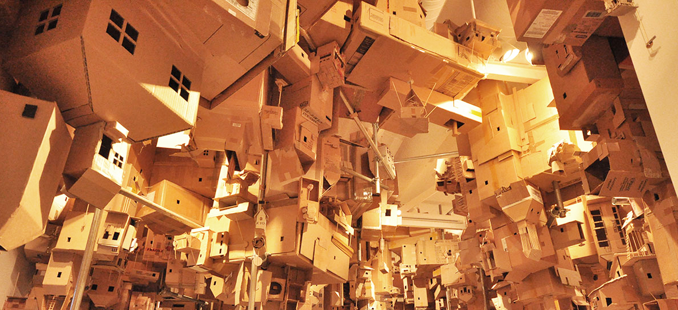

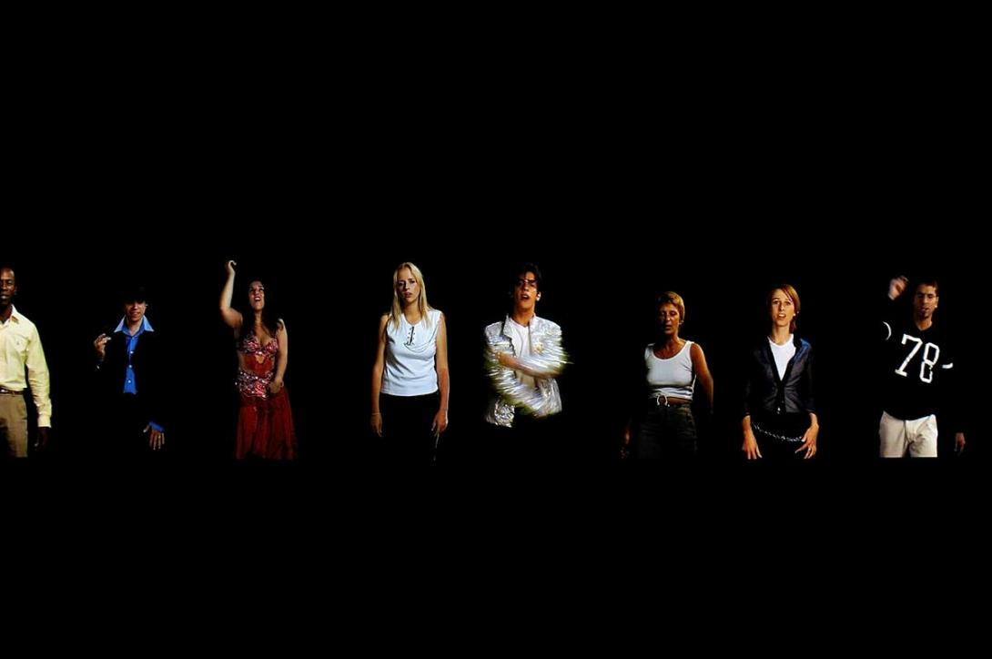
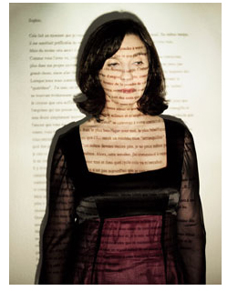
Focus 2
Alternate Authorship and Collaboration

Slide 2

Expanding art beyond the studio — into life, society, relationships.
Sharing artistic control with participants, audiences, or communities.
Inviting viewers to shape meaning and outcomes.
Challenging the idea of the “solo genius artist.”

Slide 3


Sophie Calle
Art Practice:
her work challenges the traditional notions of the role of artist and audience through her collaboration with others; blurs the idea of authorship by inviting others in to become ‘joint constructors’ of meaning in the work
Calle uses photographs and text to create narratives that are part-fact and part-fiction
she explores universal themes of vulnerability, identity, communication, memory, surveillance, public and private lives and perception in her works
she often casts herself in multiple roles as private investigator, psychologist and forensic scientist
Sophie Calle – Take Care of Yourself | TateShots
An installation of photographs, graphics, reading materials and videos in response to an actual break-up letter that Calle was sent from her boyfriend and shared with 107 female collaborators who
each contributed their interpretation of the break-up letter
Alternate Approach
Involves strangers to co-create meaning, turning private stories into public art.

Slide 4
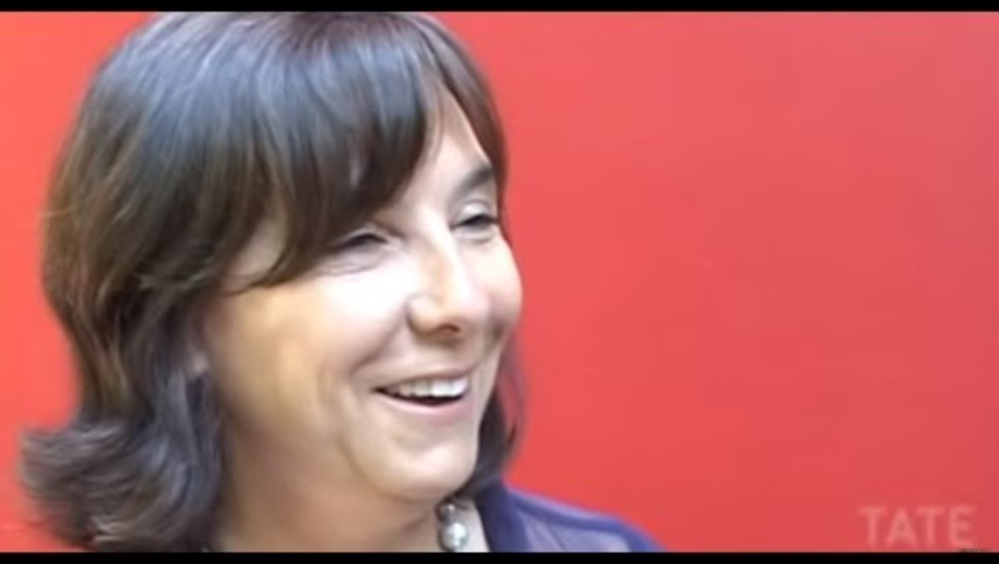
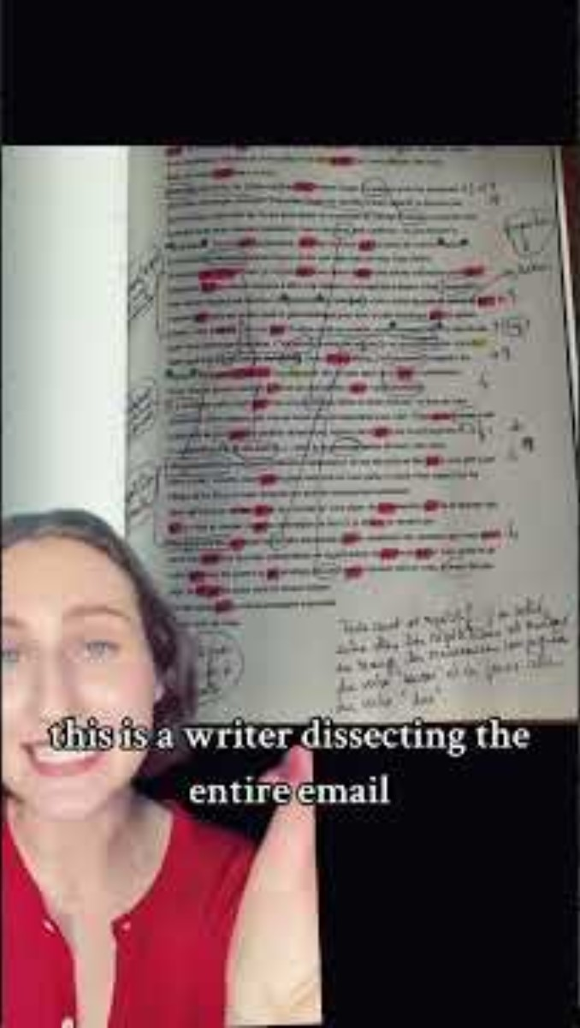
https://www.youtube.com/watch?v=Q9E4dA0EGaM
https://www.youtube.com/shorts/fyWzYmBIQe0

Slide 5
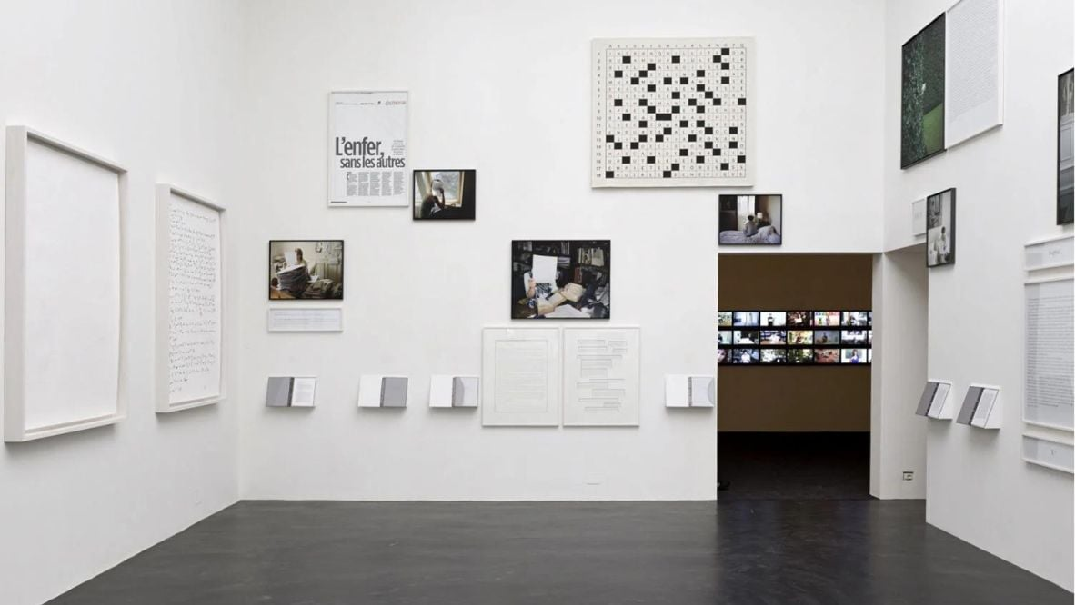
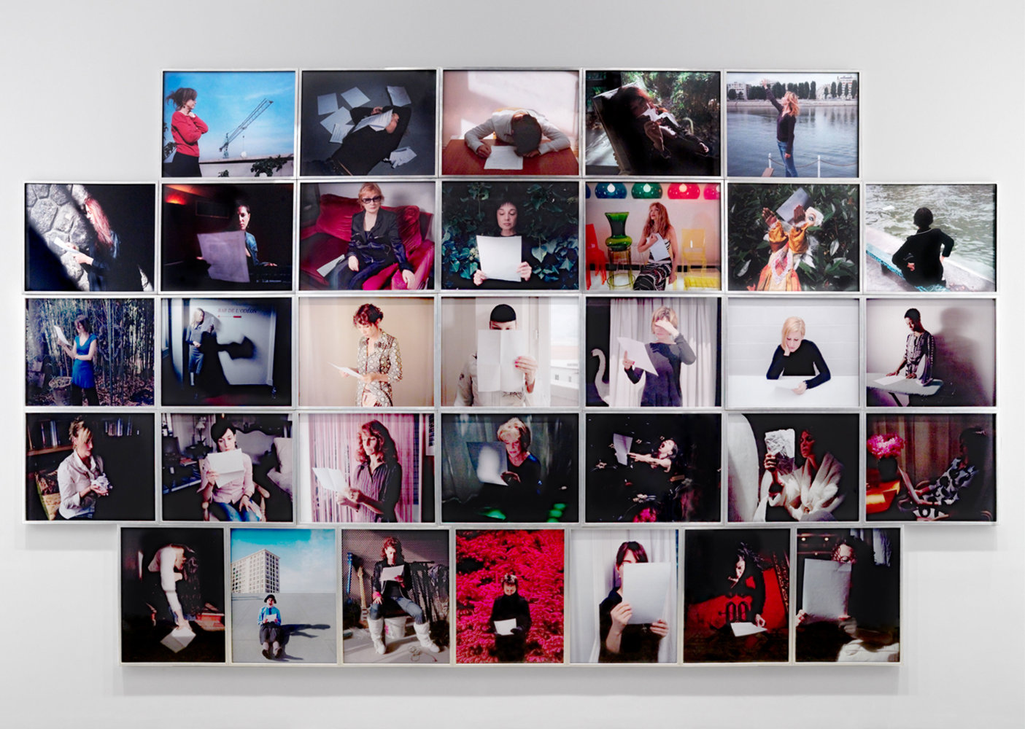
Q + A
What media and materials are utilised by Calle’s collaborators in the interpretation of the letter?
Calle’s work is often referred to as ‘conceptual art’ (art in which the idea or concept presented by the artist is considered more important than its appearance or execution.) because it has an emphasis on the artistic idea rather than the finished object. Do you agree?
What aspects and stages of this work did Calle control and have input into?
What role does Calle invite the audience to take on when viewing the artwork?
Who is the ‘author’ of this artwork?
Contexts
Formal: she uses formal arrangements and curatorial devices to contribute meaning to the final installation.
Contemporary:
purposely challenges the notion of artist as sole producer of an artwork; uses contemporary photo media and film to convey meaning
Cultural:
regarded as feminist in that her work challenges notions of female power and control and the roles of women in society
Personal:
most work explores narratives from her own life

Slide 6
Alfredo and Isabel Aquilizan
Art Practice:
work often focuses on the transience of life and people’s attempts to create a sense of permanence and belonging; also themes of marginalisation, migration and displacement (diaspora)
processes of collecting, massing and recycling with unwanted, discarded or redundant found objects and materials in the construction of large scale installations
collation, collections, accumulation and multiplicity are key terms used in critical appraisal of their work
materials communicate ideas and become signifiers of meaning
often includes sound, scent, taste and touch
set up ‘collective interaction’ to create installations; the work becomes a platform for exchange of ideas and meaning; the audience are active participants and contribute their own meaning
Set Adrift, Project Another Country
Installation consisting of cardboard houses and homes constructed in collaborative community workshops with the artists; constructions are installed in site-specific steel scaffolding
Installation is an abstracted version of homes built on stilts by the Badjao, a minority indigenous people who live in the Philippines and are considered ‘ocean refugees’
Alternate Approach
Invite communities to build the work, making art a collective process.

Slide 7
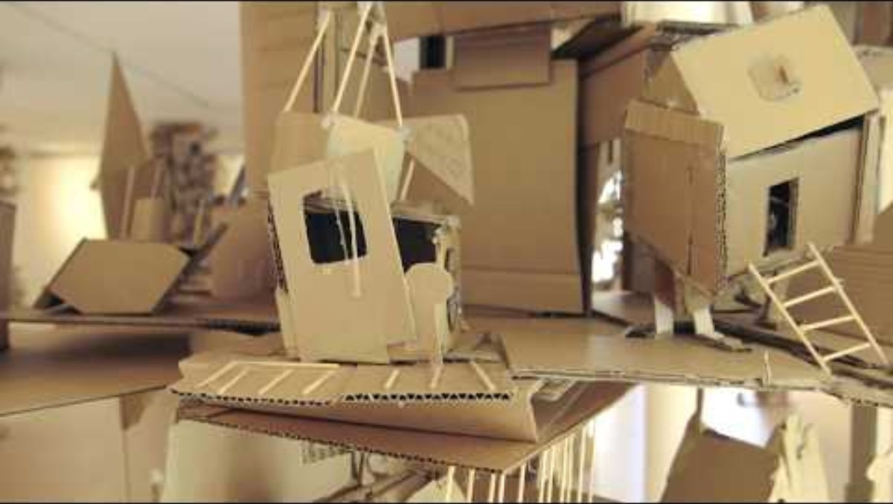
https://www.youtube.com/watch?v=DFu6jGPiehY

Slide 8
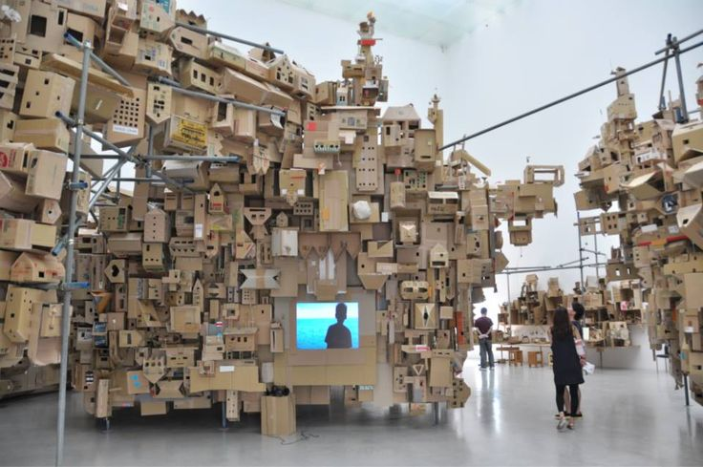
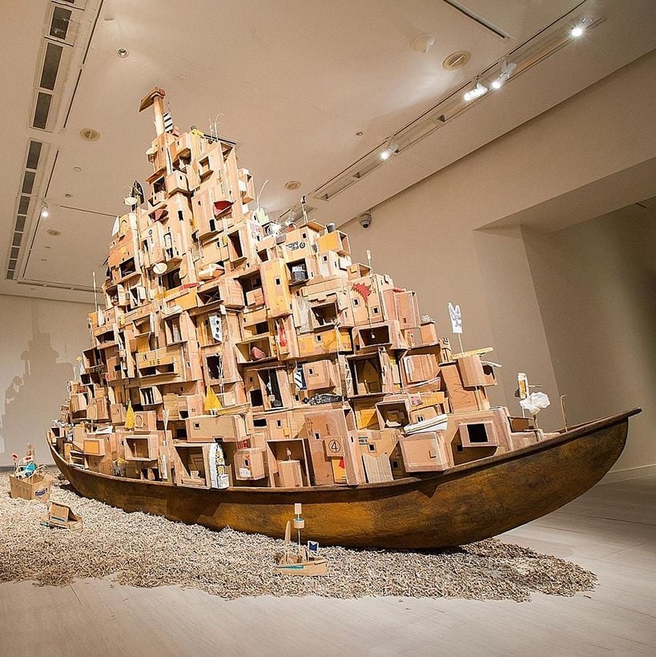
Contexts
Formal: uses formal arrangements and repetition to create aesthetic interest and unity in their works.
Contemporary: communication of contemporary issues such as migration and displacement; active participation from audiences to construct meaning
Cultural: explore realties and representations that intersect between their Asian background and Australian lifestyle
Personal: draw upon their own experience of migrating from the Philippines to Australia and other real-life experiences
Q + A
Why did the Aquilizans choose cardboard as the primary material
create this artwork?
How do the Aquilizans rely on others to be ‘joint constructors’ of meaning in this artwork?
What aesthetic qualities does the completed installation have and how important are these attributes to the success of the artwork?

Slide 9

Candice Breitz
Art Practice:
Breitz primarily works in video and photography and often refers to and appropriates images from popular culture
her work questions the influences and impact of media, celebrity and language on the individual’s sense of self
she collaborates with ordinary people and found footage, which she cuts, selects and remixes to form new relationships
King (A Portrait of Michael Jackson), 2005
16-channel video work. Breitz recruited participants via advertisements she placed on Michael Jackson fan sites. She selected 16 of the most authentic and fanatical fans and recorded each of them performing the entire Thriller album. Footage of them performing a cappella is presented in unison in screen-test mode across 16 screens in the gallery. The performance is both captivating and awkward
The work explores the relationship between iconic stars such as Michael Jackson and communities of fans
Identity of the star and the fan become blurred, turning the fans’ passive consumption into active production
Fans appropriate Michael Jackson to create their own interpretation; Candice Breitz appropriates and curates the performances of the participants to create her own work of art — a double game of appropriation
Alternate Approach
Merges intimate testimony with mass media to explore identity.

Slide 10
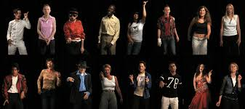
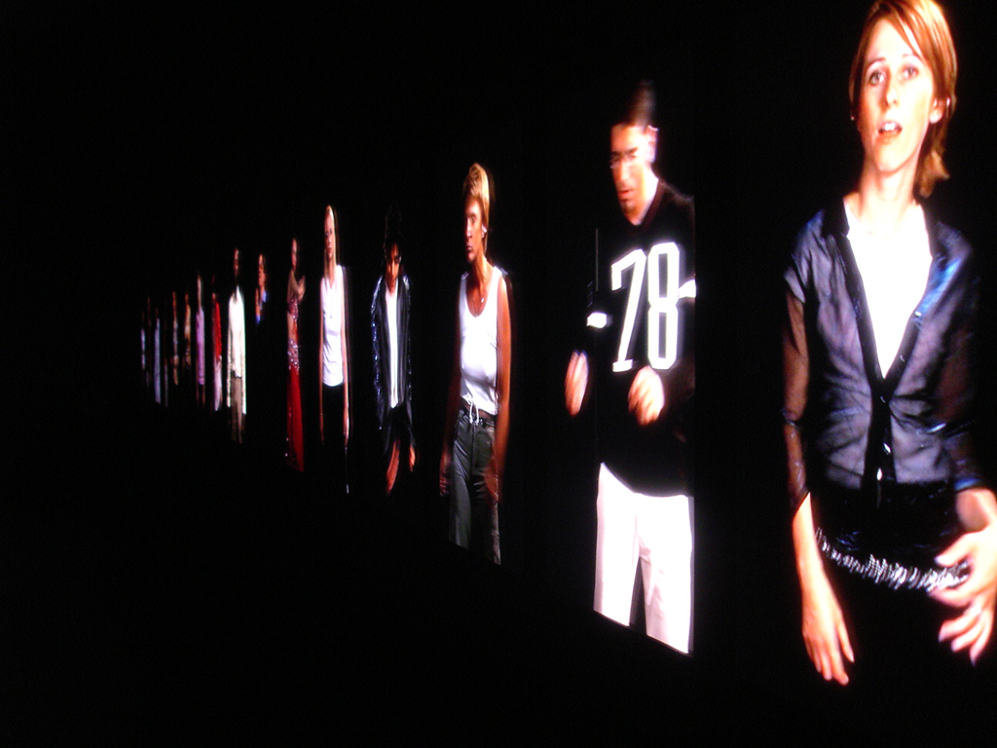
Contexts
Formal:
communicates meaning through the skilful use of time-based media and careful control of elements of film language such as editing and sound design.
Contemporary:
use of found media and HD digital film to comment on contemporary popular culture
Cultural:
works are constructions of specific moments in pop culture that reflect society; appropriates time and place
Personal:
uses images that can be interpreted as personal metaphors for how we live our lives in a media-saturated environment
Q + A
What parameters and controls did Breitz as the artist set up in order to obtain the collaborative response she determined necessary for this portrait?
How did Breitz install and curate this work to ensure that it communicated her intent effectively to viewers?
https://www.dailymotion.com/video/x6xo60n

